Slide 1
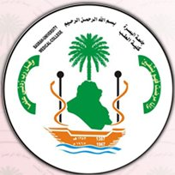

Autonomic Nervous System
L2
Dr. Massara Ghassan
Physiology Department
College of Medicine\ University of Basrah

Slide 2
Objectives:
After studying this lecture, you should be able to:
Describe functions of the sympathetic and parasympathetic nervous systems
List the causes of the localized discrete effect of the anabolic nervous system
List the causes of the widespread diffuse & prolonged effects the catabolic nervous system
Differences between Sympathetic and Parasympathetic NS

Slide 3
Function of ANS
All the viscera (glands, smooth mus. &sphincters) are supplied by Sympathetic &parasympathetic N. in which they are in antagonism for the same organ, except:
to the sphincters both of them are excitatory
(e.g. :sphincter of the eye)?
Because one supply the constrictor & the other supply the dilator muscles.

Slide 4
2. The effects of sympathetic and parasympathetic activation can be considered complementary.
An example is the innervation of salivary glands. Parasympathetic causes release of watery saliva, Sympathetic activation causes the production of thick, viscous saliva.

Slide 5
Organs supplied only by Sympathetic.
adrenal gland
most blood vessels
3. the pilomotor muscles in the skin (hair follicles)
4. sweat glands.

Slide 6
Organs supplied only by parasympathetic
The lacrimal muscle
Ciliary muscle (for accommodation for near vision)
Sublingual salivary gland.
**

Slide 7
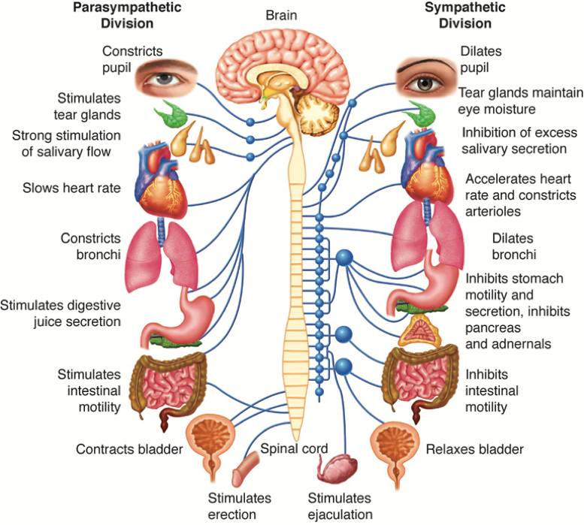

Slide 8
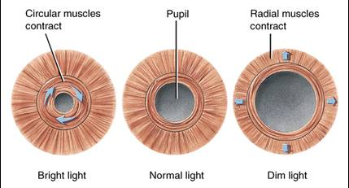
Effects of Sympathetic and Parasympathetic Stimulation on Specific Organs
1. Eyes
a. the pupillary opening

Slide 9
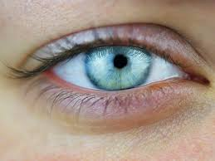
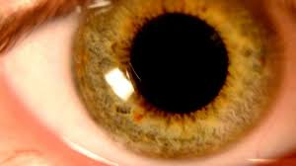
miosis
mydriasis

Slide 10
b. Focusing of the lens is controlled almost entirely by the parasympathetic nervous system
Parasympathetic excitation contracts the ciliary muscle,
which will allow the lens to become more convex, causing the eye to focus on near objects.

Slide 11
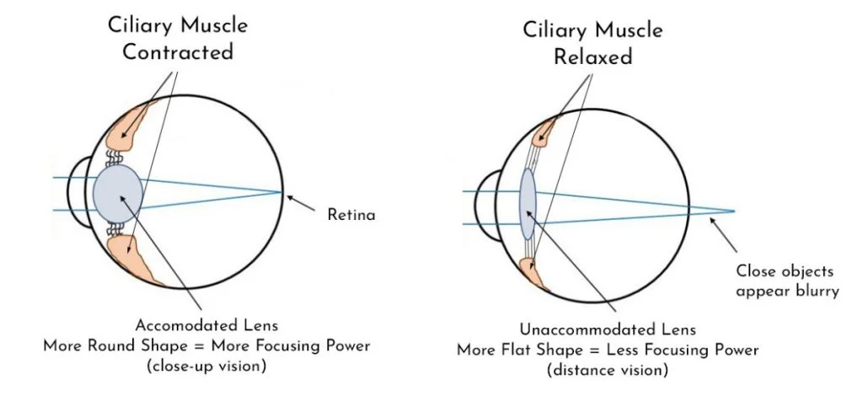

Slide 12
Glands of the Body.
The nasal, lacrimal, salivary, and many gastrointestinal glands are strongly stimulated by the parasympathetic nervous system, usually resulting in copious quantities of watery secretion.
The glands of the alimentary tract most strongly stimulated by the parasympathetics are those of the upper tract, especially those of the mouth and stomach.

Slide 13
On the other hand, the glands of the small and large intestines are controlled principally by local factors in the intestinal tract itself and by the intestinal enteric nervous system.

Slide 14
The sweat glands
secrete large quantities of sweat when the sympathetic nerves are stimulated, but no effect is caused by stimulating the parasympathetic nerves. However,
the sympathetic fibers to most sweat glands are cholinergic (except for a few adrenergic fibers to the palms and soles)

Slide 15
Systemic Blood Vessels
Most systemic blood vessels, especially those of the abdominal viscera, skin & of the limbs, are constricted by sympathetic stimulation
(because alpha vasoconstrictor effects, which, in most blood vessels, are usually far dominant over the beta)

Slide 16
Parasympathetic stimulation has almost no effects on most blood vessels.
Under some conditions, the beta function of the sympathetic or the sympathetic cholinergic causes vascular dilation instead of the usual sympathetic vascular constriction, as in skeletal muscles.

Slide 17
Other effects of sympathetic nervous system
Increases metabolism up to 100%
Increases adrenal medullary secretion
Increases mental activity
Increases skeletal muscle glycogenolysis and Increases it’s strength

Slide 18
Alarm or stress response mass discharge
the blood pressure and heart rate
Pupillary diltation
constricts the blood vessels
Blood
glucose
Metabolic rate
Rate & depth of resp.
Mental activity
Muscle strength

Slide 19
sympathetic system
Catabolic nervous system

Slide 20
Why sympathetic system usually has widespread diffuse & prolonged effects?
A single preganglionic fiber usually synapse with several postganglionic N.
The postgang. Fibers are long & has many branches projecting to several visceral organs.
Neuronal reuptake of N.E. is incomplete
Activation of the adrenal medulla

Slide 21
parasympathetic system
Concerned with the vegetative aspect of day to day living ( it favors digestion & absorption of food by increasing muscle Activity, gastric secretion, &relaxation of pyloric sphincter.
Anabolic nervous system.

Slide 22
Why parasympathetic system usually has localized discreet effects ?
parasympathetic preganglionic Axons have very little branches and go directly to parasympathetic Ganglia.
Ach. Is rapidly destroyed by acetylcholinesterase enzyme.
Mainly the P.S.N.is activated in response to reflexes according to the need of a particular organ

Slide 23



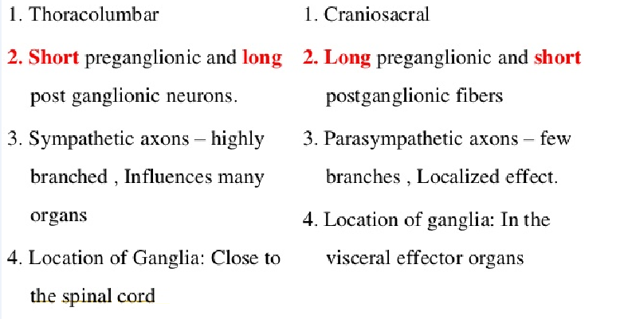

Slide 24
Recap
Functions of autonomic NS on various organs
Sympathetic act as catabolic NS
Parasympathetic act as anabolic NS

Slide 25
Thank You

